Slide 1
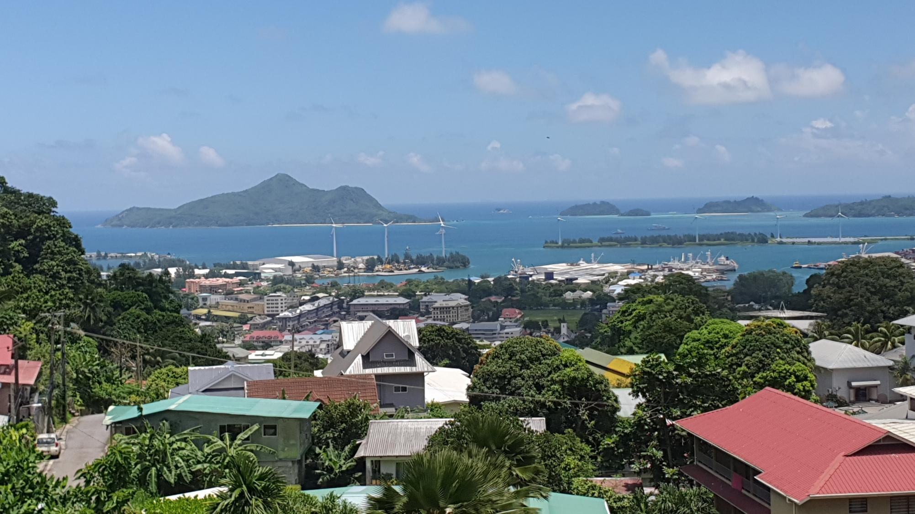


Structuring Information for the National Climate Transparency Platform (NCTP)
DIGITAL 4 PLANET
Training support for implementing the NCTP
V1 – March 2025
UNITED NATIONS DEVELOPMENT PROGRAMME

Slide 2

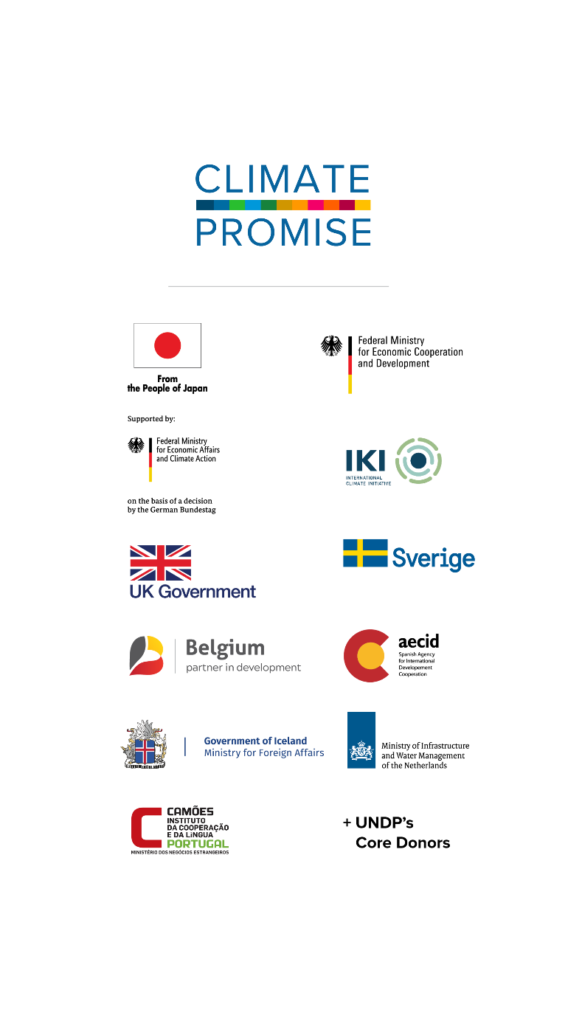
What this training includes:
About This Training
Introduction to the Information Structure of NCTP
Mapping National Climate Change Information
Climate Change Transparency Information Flows
- Programmatic Information
- Impact Information
- Advanced Impact Information Screening
Insights for Some Sectors
Other Useful Resources
UNITED NATIONS DEVELOPMENT PROGRAMME
Notes:
While global commodity companies gather extensive data on farmland, farm inputs, and monitor unsustainable practices, local farmers often lack access to and utilization of this data

Slide 3


1. About This Training
The Companion Guide
The National Climate Transparency Platform (NCTP)
UNITED NATIONS DEVELOPMENT PROGRAMME

Slide 4
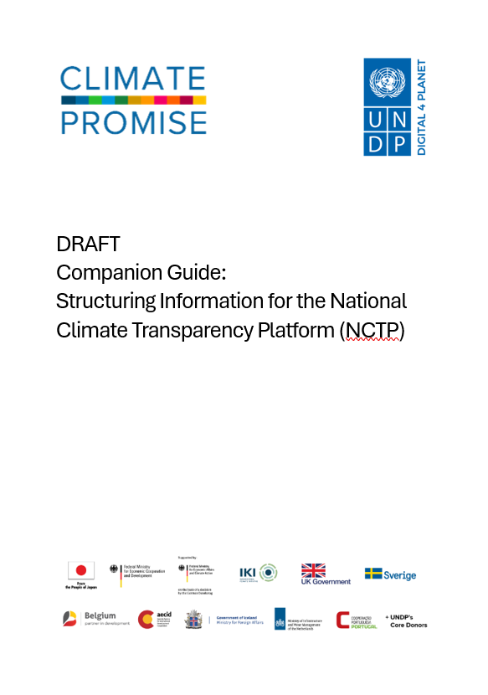
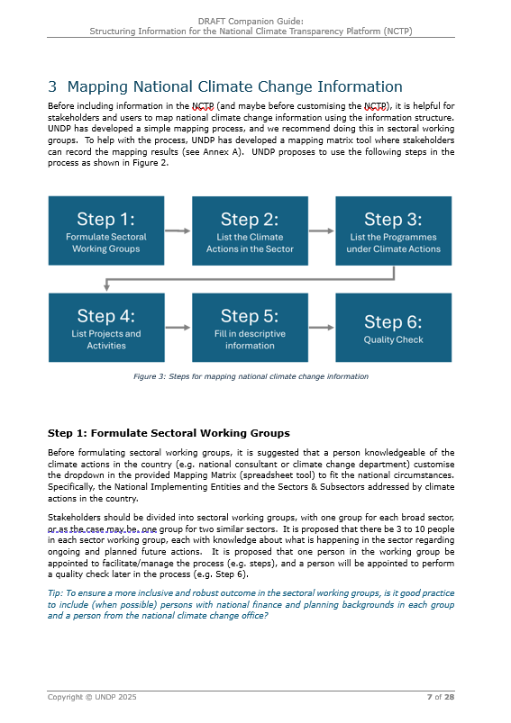
The Companion Guide:
Structuring Information for the (NCTP)
The Companion Guide is made to help national stakeholders with the process of structuring and preparing information so it can be inputted into the modules of the NCTP.
The Guide includes step-by-step instructions on how working groups can identify and input information into a simple Mapping Matrix Tool (Excel) for ease of process.
The Guide also offers simple sectoral insights that can help in the process above and identifies different resources that may be helpful.

Slide 5
Key Benefits of the NCTP
1.
Save time and lead to less work
Quick overview of progress and support (needed and received)
2.
Provide a common point for information
Common system for all of Government to use
3.
Facilitate support needed for change
Gives an overview of financial, capacity building, and technical support
Government departments can directly input sectoral information (lading to less time chasing it down)
Information is stored long term and easy to find (even after staff leaves)
Central place to store and access climate change related information
Simple extraction of data for other uses, and direct integration with international platforms
Access additional support by making it easier to address development partners
Track progress and results of past and current support.

Slide 6

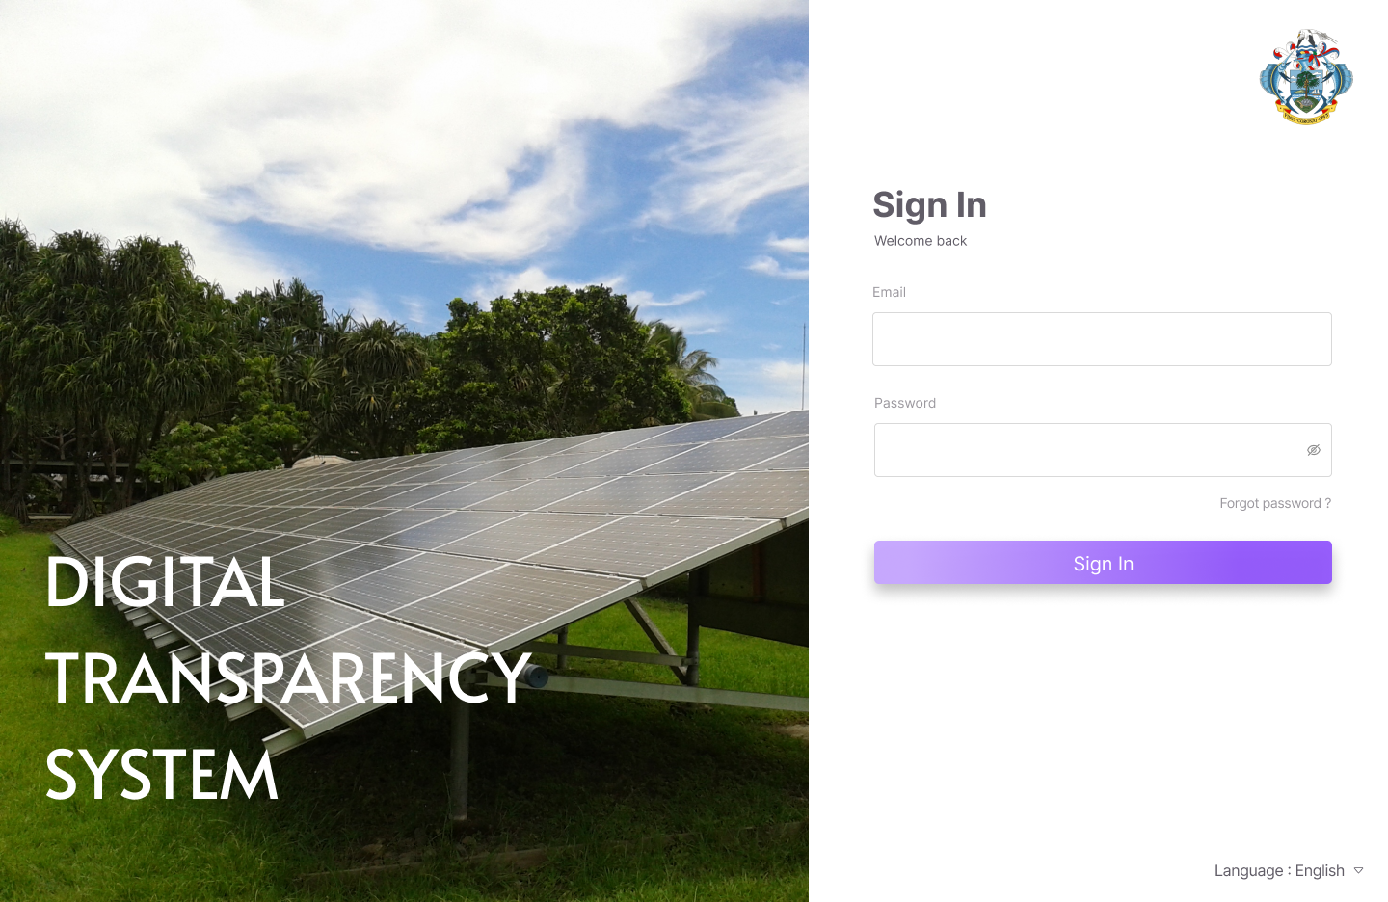
Common Users of the NCTP
System Administrator(s):
Central manager of climate change information
Government User(s):
Government departments
Consultants
SEOs
Observer(s):
Technical reviewers from the UNFCCC
Development partners
UNITED NATIONS DEVELOPMENT PROGRAMME

Slide 7
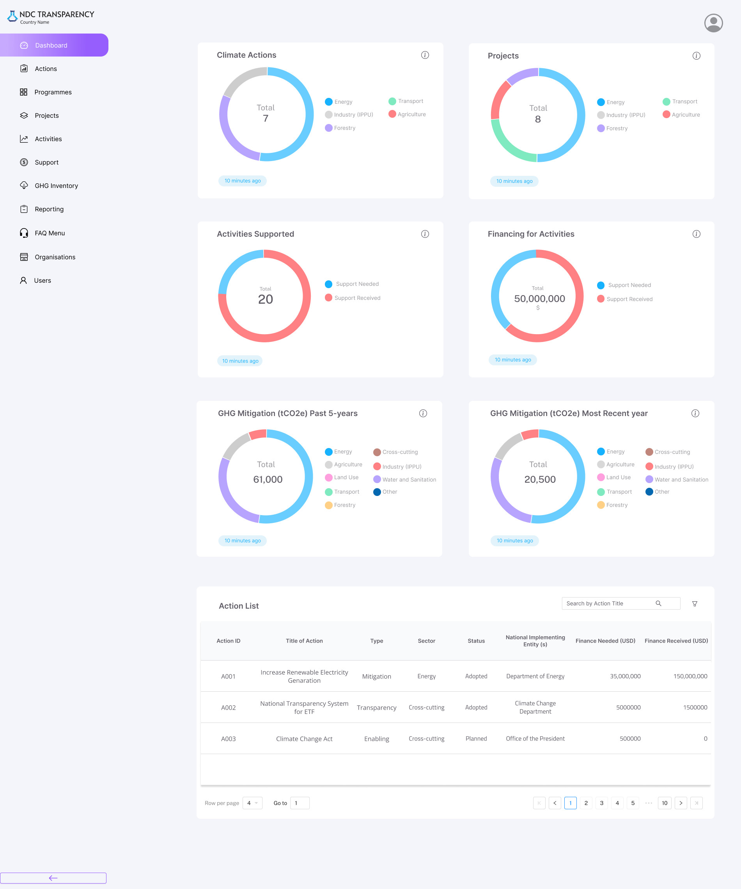
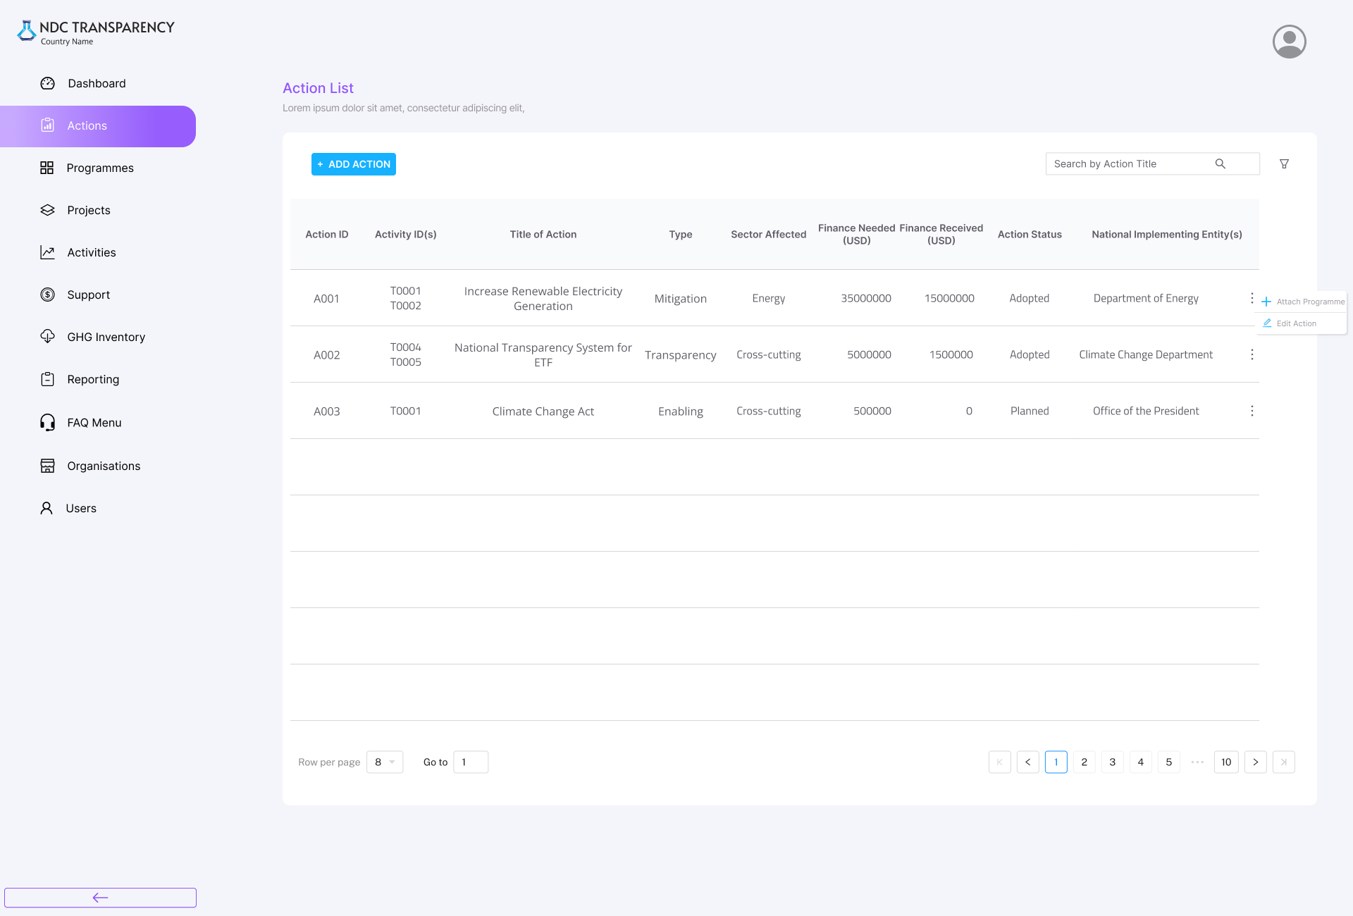
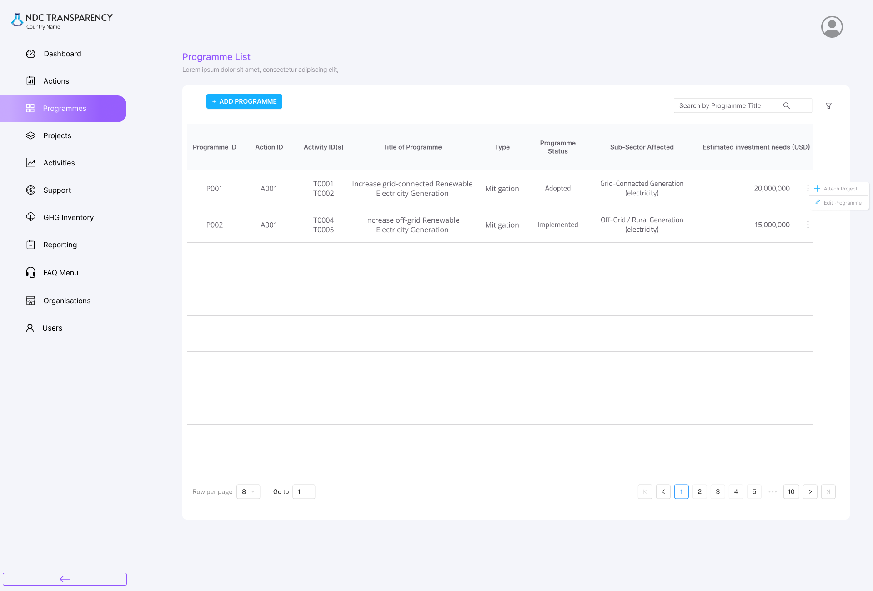
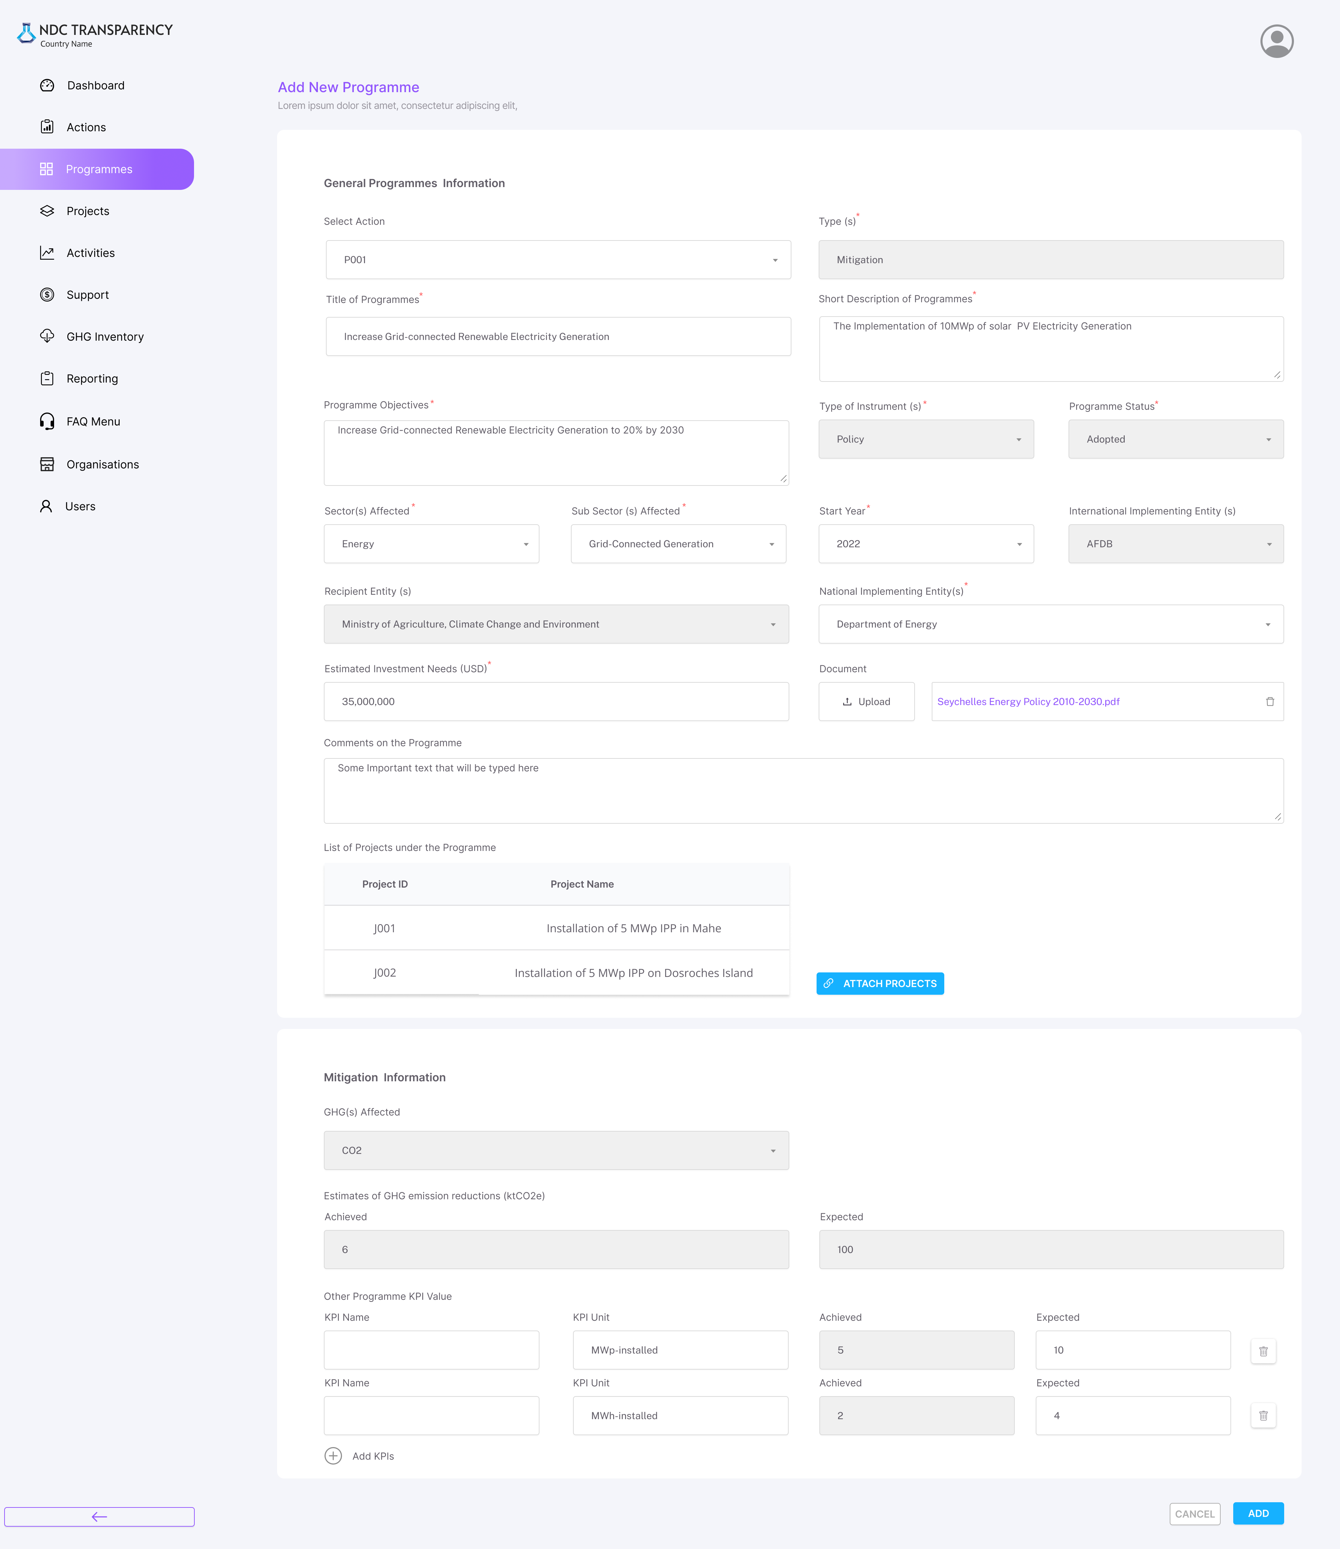
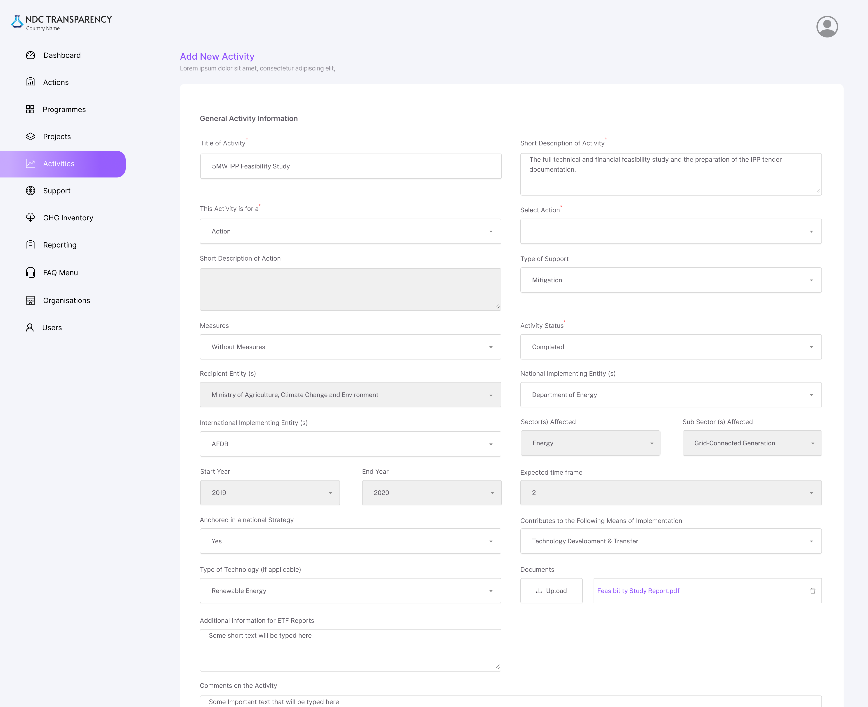
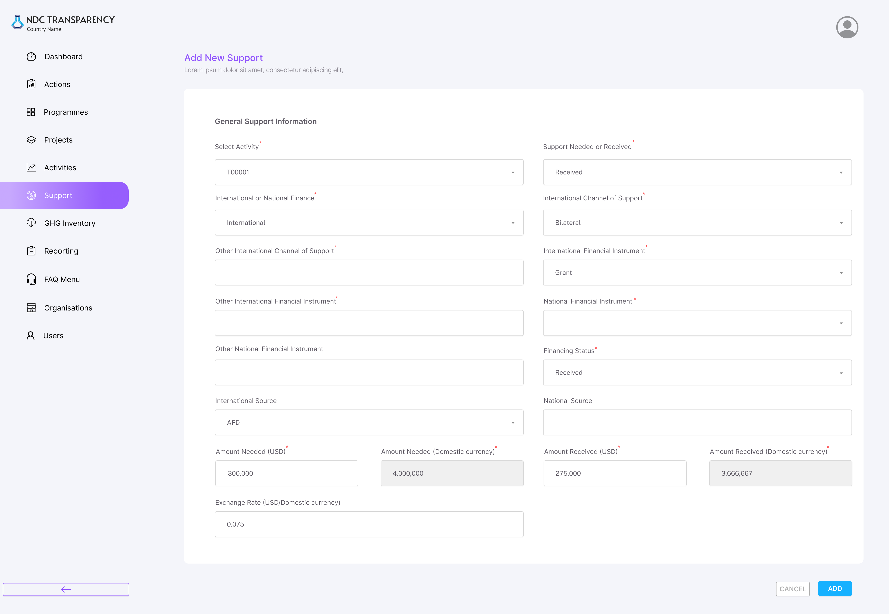
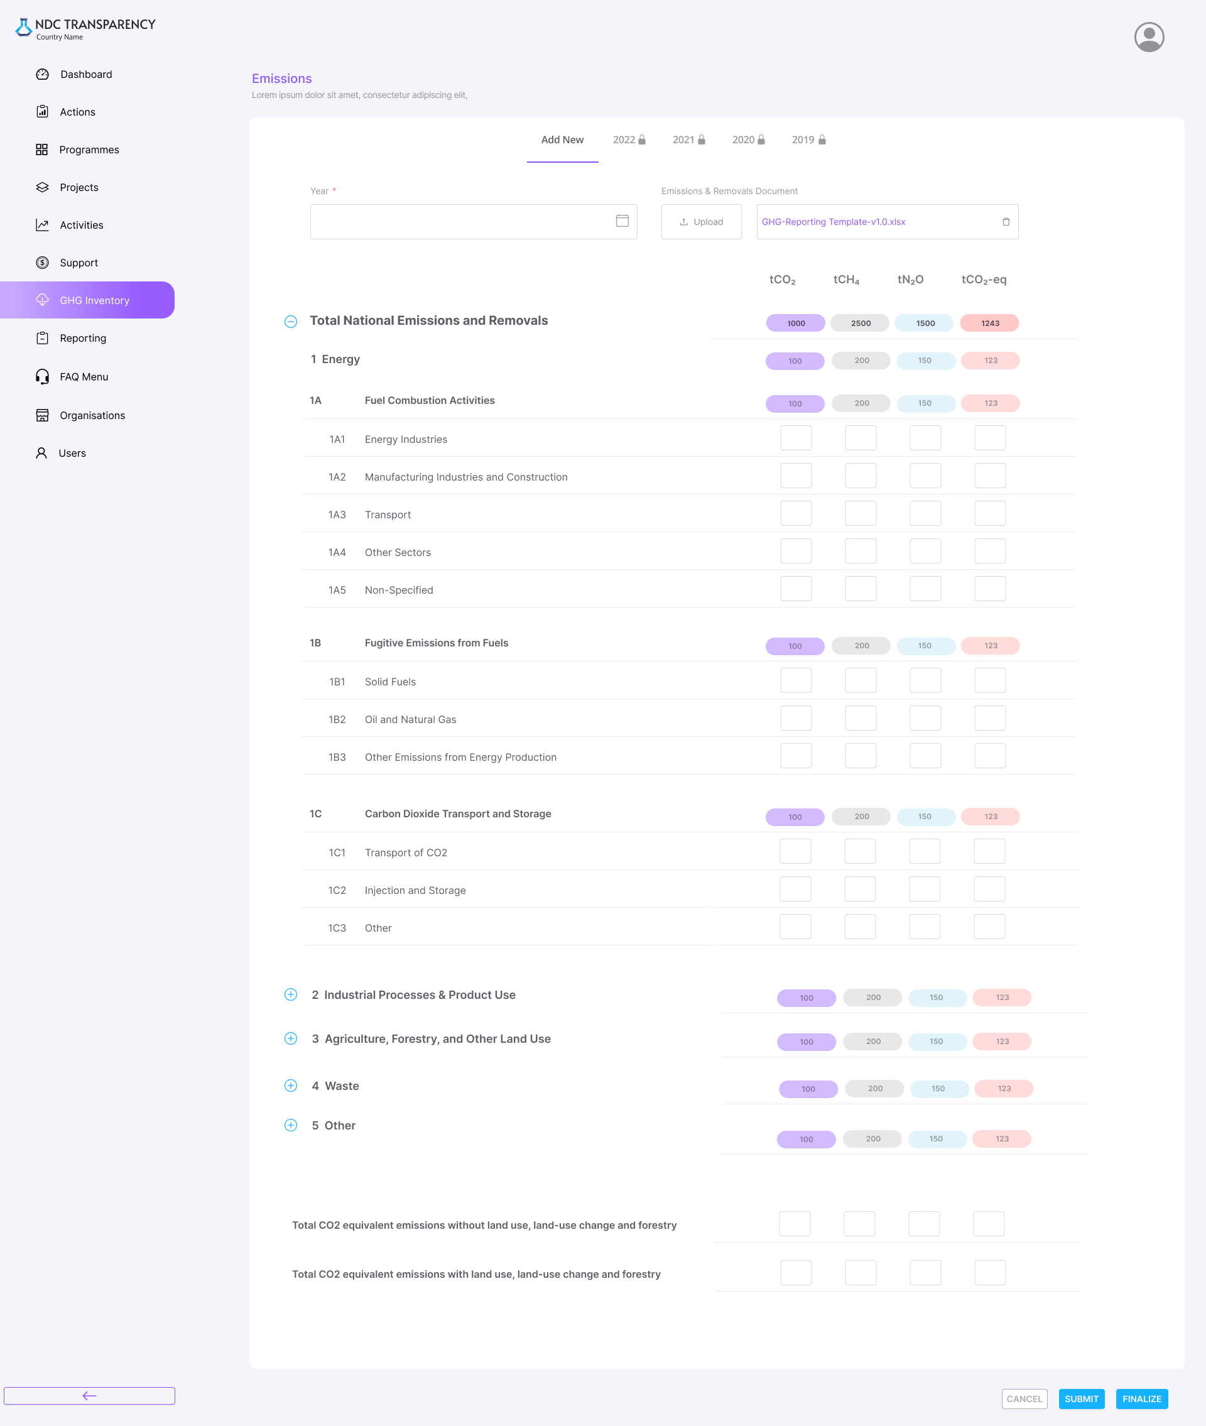
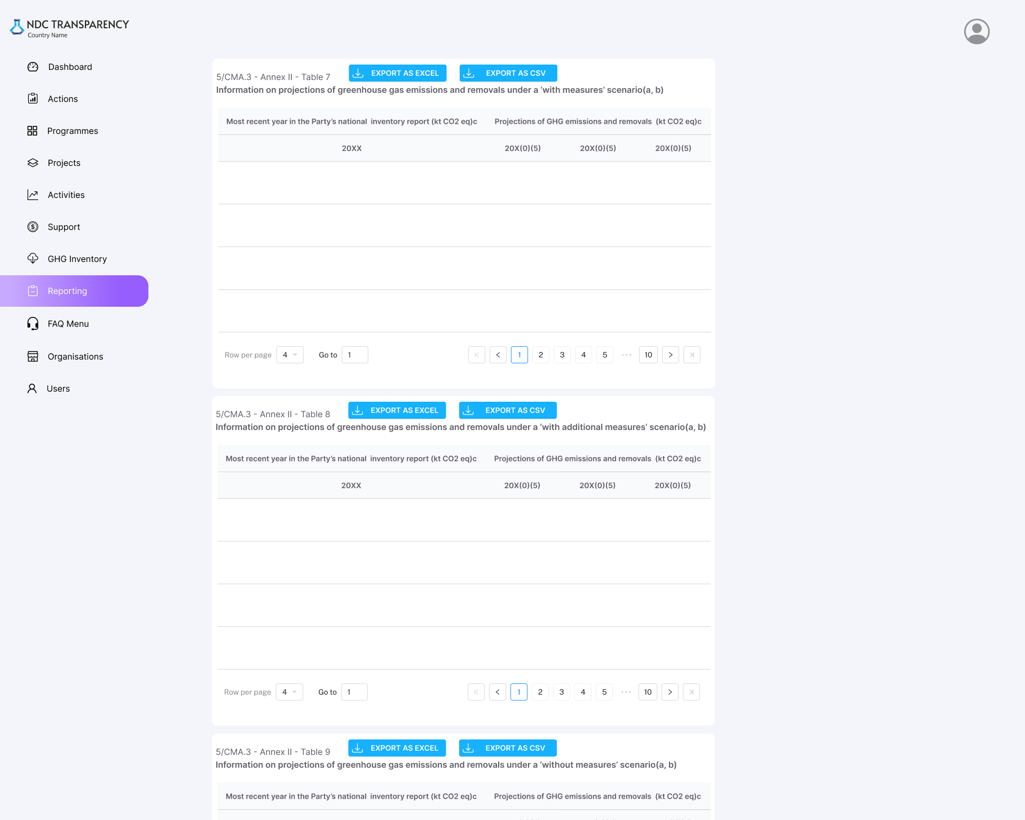
What’s included in the NCTP (the modules)
Overview Dashboard
Actions
Programmes
Projects
Activities
Support
GHG Emissions
Reporting (CTFs)
7
UNITED NATIONS DEVELOPMENT PROGRAMME

Slide 8
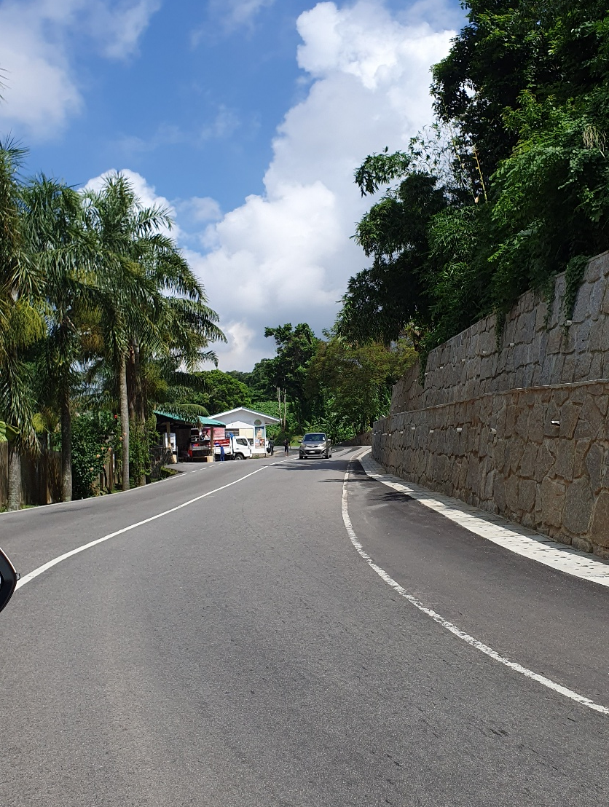
2. Introduction to the Information Structure of NCTP
The Information Structure
UNITED NATIONS DEVELOPMENT PROGRAMME

Slide 9
The National Climate Transparency Platform (NCTP)
Actions: are the sectoral climate actions for mitigation, adaptation, cross-cutting, and transparency defined in the NDC, NAP, and other national policy & planning.
The NCTP structure is based on a common process and information structure used by governments and development partners for managing work to address climate change.
This structure is based on the core components of climate Actions, Programmes, Projects, and Activities, each with a different purpose in the structure and different types of information.
Using this structure, the NCTP allows governments to consolidate information bottom-up for a broad overview of progress in addressing climate change while also allowing for digging into the details of in sectors.
Programmes: (one or more) fall under an Action, and may focus on specific sub-sectors, set of stakeholders, or type of technology / practice that are being deployed under the parent Action.
Projects: (one or more) fall under a Programme, and are the most common structure for managing a set of specific Activities. Projects are also the most common structure for channelling specific development support and interventions in a country.
Activities: (one or more) fall under a Project, and are the efforts done to make transformative change happen in practice.
Support: takes the form of finance, capacity building, and technology transfer & assistance and may be provided (linked) to any of the other components

Slide 10

Actions and Programmes
Actions: are the sectoral climate actions for mitigation, adaptation, cross-cutting, and transparency defined in the NDC, NAP, and other national policy & planning.
Programmes: (one or more) fall under an Action, and may focus on specific sub-sectors, set of stakeholders, or type of technology / practice that are being deployed under the parent Action.

Slide 11

Projects, Activities and Support
Projects: (one or more) fall under a Programme, and are the most common structure for managing a set of specific Activities. Projects are also the most common structure for channeling specific development support and interventions in a country.
Activities: (one or more) fall under a Project, and are the efforts done to make transformative change happen in practice.
Support: takes the form of finance, capacity building, and technology transfer & assistance and may be provided (linked) to any of the other components
Actions
Projects
Programmes
Activities

Slide 12
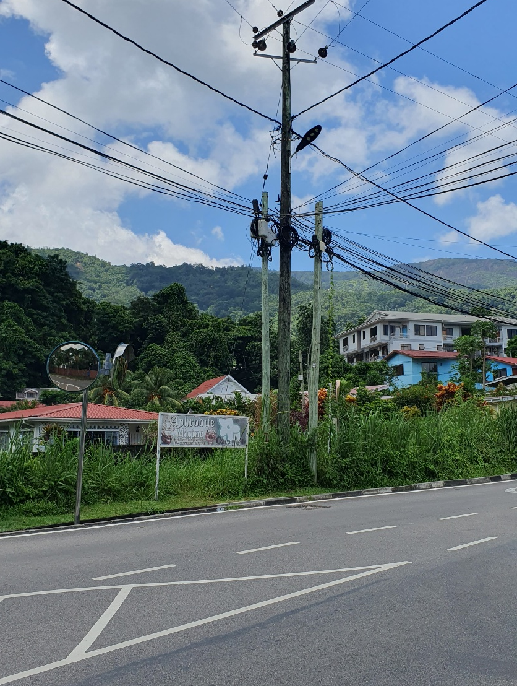
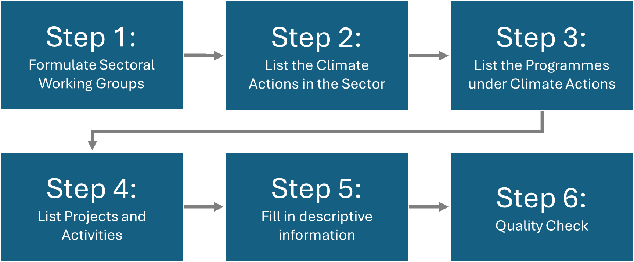
3. Mapping National Climate Change Information
UNITED NATIONS DEVELOPMENT PROGRAMME

Slide 13

Step 1: Formulate Sectoral Working Groups
Mapping Matrix: customise the dropdown in the provided Mapping Matrix (spreadsheet tool) to fit the national circumstances. Specifically, the National Implementing Entities and the Sectors & Subsectors addressed by climate actions in the country.
Sector Groups: Stakeholders should be divided into sectoral working groups, with one group for each broad sector, or as the case may be, one group for two similar sectors.
Members: It is proposed that there be 3 to 10 people in each sector working group, each with knowledge about what is happening in the sector regarding ongoing and planned future actions. It is proposed that one person in the working group be appointed to facilitate/manage the process

Slide 14
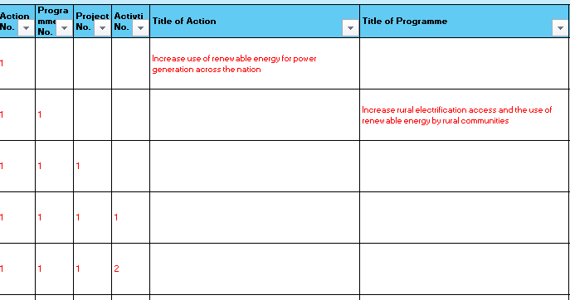
Step 2: List the Climate Actions in the Sector
Step 3: List the Programmes under Climate Actions
Actions: Climate actions include types for GHG mitigation, adaptation, cross-cutting (e.g., both GHG mitigation and adaptation), and transparency (e.g., information systems and reporting). It is essential to list the type of action, the sector impacted, and the primary entity responsible for implementation.
Programmes: communicate to list the programmes that fall under each of the climate actions that are taking place in the country, both planned and under implementation. It is essential to list the type of programme, the sector and sub-sector impacted, and the primary entity responsible for implementation.

Slide 15
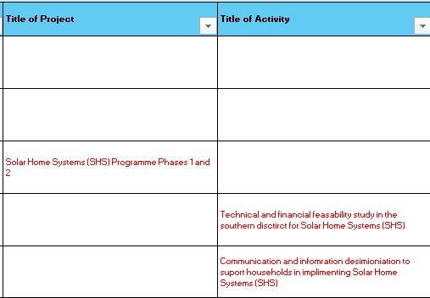
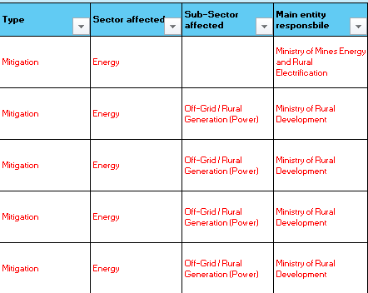
Step 4: List Projects and Activities
Projects & Activities: List projects, and the activities under each project, directly in the provided Mapping Matrix tool.
Type, Sector, Entity: It is essential to list the type of project and activities, the sector and sub-sector impacted, and the primary entity responsible.

Slide 16
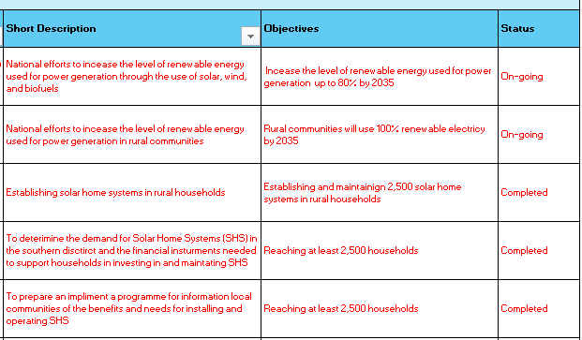
Step 5: Fill in descriptive information
Description: A short two-sentence description of the objectives of the Actions, Programmes, Projects and Activity.
Objective: A short one-line description of the objectives of the Actions, Programmes, Projects and Activity.
Status: Indicate the status of the Actions, Programmes, Projects and Activity as Completed, On-going, or Planned

Slide 17

Step 6: Quality Check
Quality Check (validation):
It is proposed that one person from the working group (or two) be nominated to perform a quality check of the information inputted into the provided Mapping Matrix tool. This person(s) will hold the combined draft and final mapping versions of the tool.

Slide 18

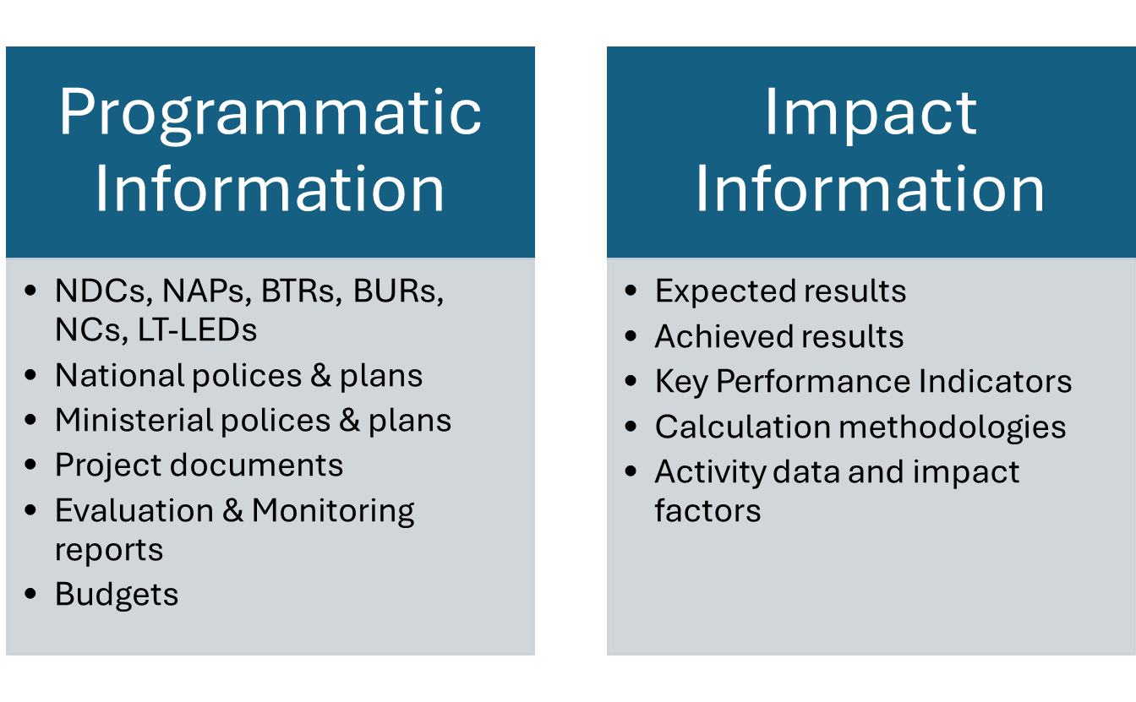
4. Climate Change Transparency Information Flows
Two categories of information
UNITED NATIONS DEVELOPMENT PROGRAMME

Slide 19
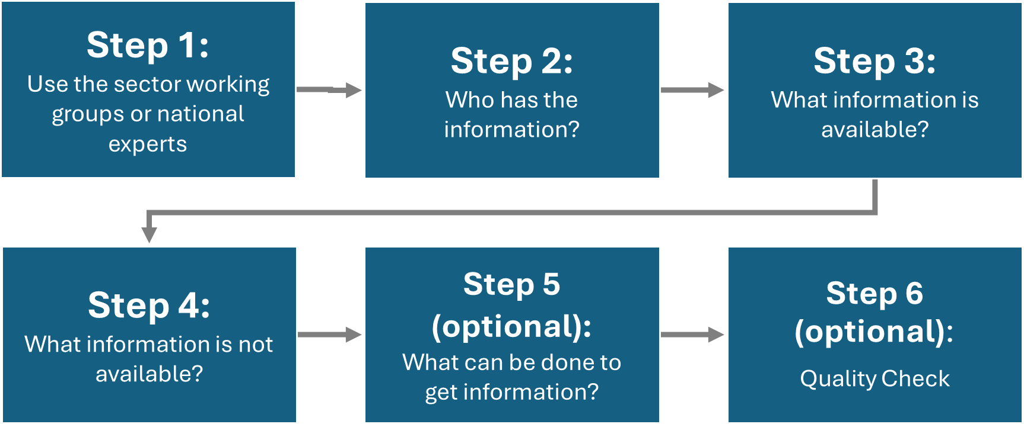
Mapping Programmatic Information

Slide 20
Step 1: Use the sector working groups or experts
Sector Groups: Identify the working groups or national experts that will be able to map the programmatic information for each sector.

Slide 21
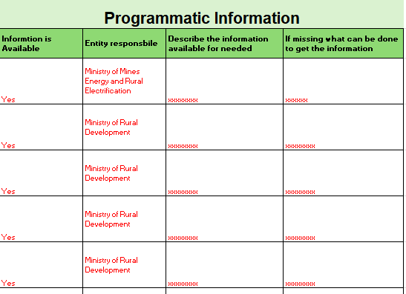
Step 2: Who has the information?
Step 3: What information is available?
Step 4: What information is not available?
Who has it: Identify the entities with programmatic information for the listed actions, programmes, and projects. If there is information that no entity has or is not available, then identify the entity most likely to develop or obtain that information.
Available or not: Identify and record what programmatic information is available (and sources) for the listed actions, programmes, and projects. Then, Identify what programmatic information is unavailable for the listed actions, programmes, and projects.

Slide 22
(optional steps)
Step 5: What can be done to get information?
Step 6: Quality Check
Getting Information: As an option for programmatic information that is not available, propose activities that can be taken to develop and/or secure that information, as well as the potential entity that can perform that activity.
Quality Check (validation): It is proposed that one person from the working group (or two) be nominated to perform a quality check of the information inputted into the provided Mapping Matrix tool. This person(s) will hold the combined draft and final mapping versions of the tool.

Slide 23
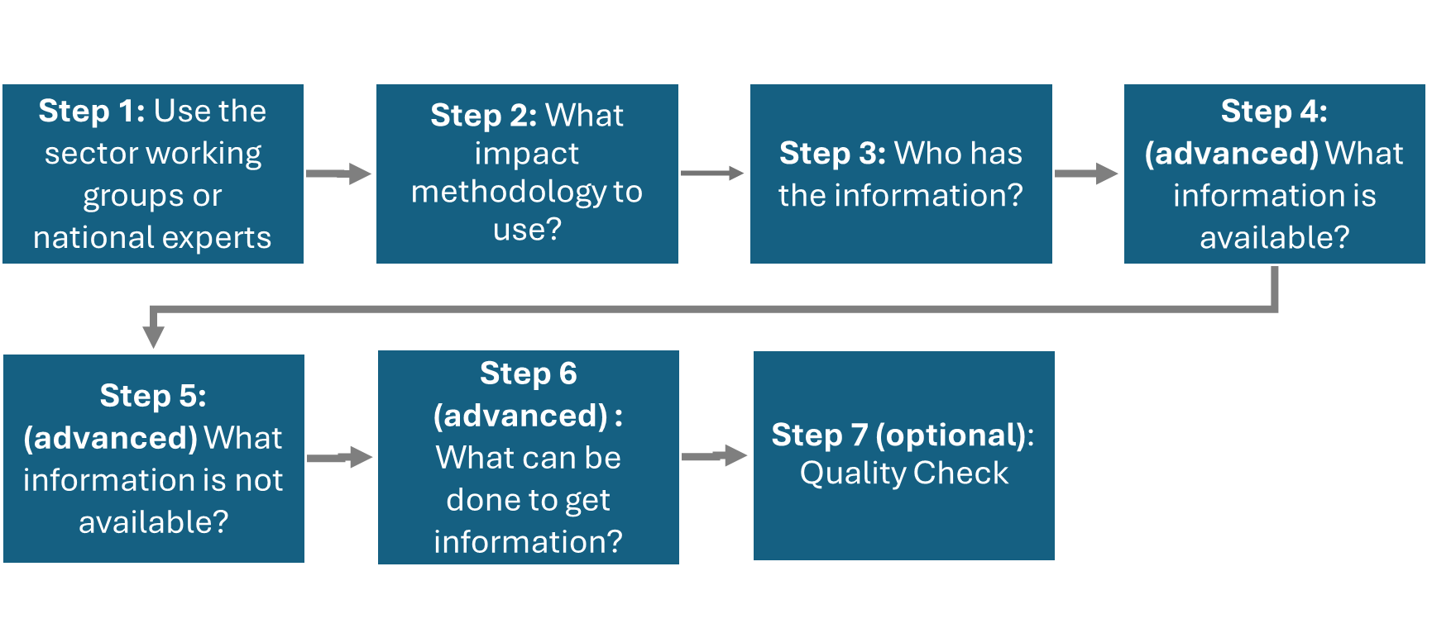
Mapping Impact Information

Slide 24
Step 1: Use the sector working groups or experts
Sector Groups: Identify the working groups or national experts that will be able to map the programmatic information for each sector.

Slide 25
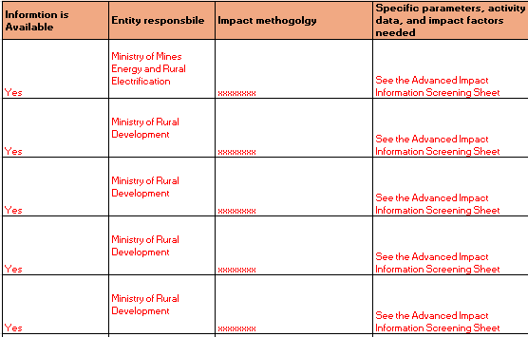
Step 2: What impact methodology to use?
Step 3: Who has the information?
Methodology: Identify the impact methodology for calculating (quantitative impact) or determining (qualitative impact) the expected and actual results of actions, programmes. and projects. Then identify the different parameters, activity data, and impact factors needed to use the methodology.
Who has it: Identify entities with the impact information (parameters, activity data, and impact factors) for the listed actions, programmes, and projects. If there is unavailable information, then identify the entity most likely to develop or obtain that information.

Slide 26
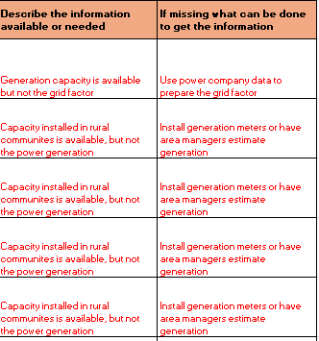
(advanced)
Step 4 & 5: Information available or not?
Step 6: What can be done to get information?
Available or not: Identify what impact information is available (and sources), or unavailable, for the listed actions, programmes, and projects . There are often 3 to 15 parameters, activity data, and impact factors needed for each as defined by the methodology
How to get it: As an option for impact information that is not available, propose activities that can be taken to develop and/or secure that information, as well as the potential entity who can perform that activity.

Slide 27
(optional)
Step 6: Quality Check
Quality Check (validation):
It is proposed that one person from the working group (or two) be nominated to perform a quality check of the information inputted into the provided Mapping Matrix tool. This person(s) will hold the combined draft and final mapping versions.

Slide 28
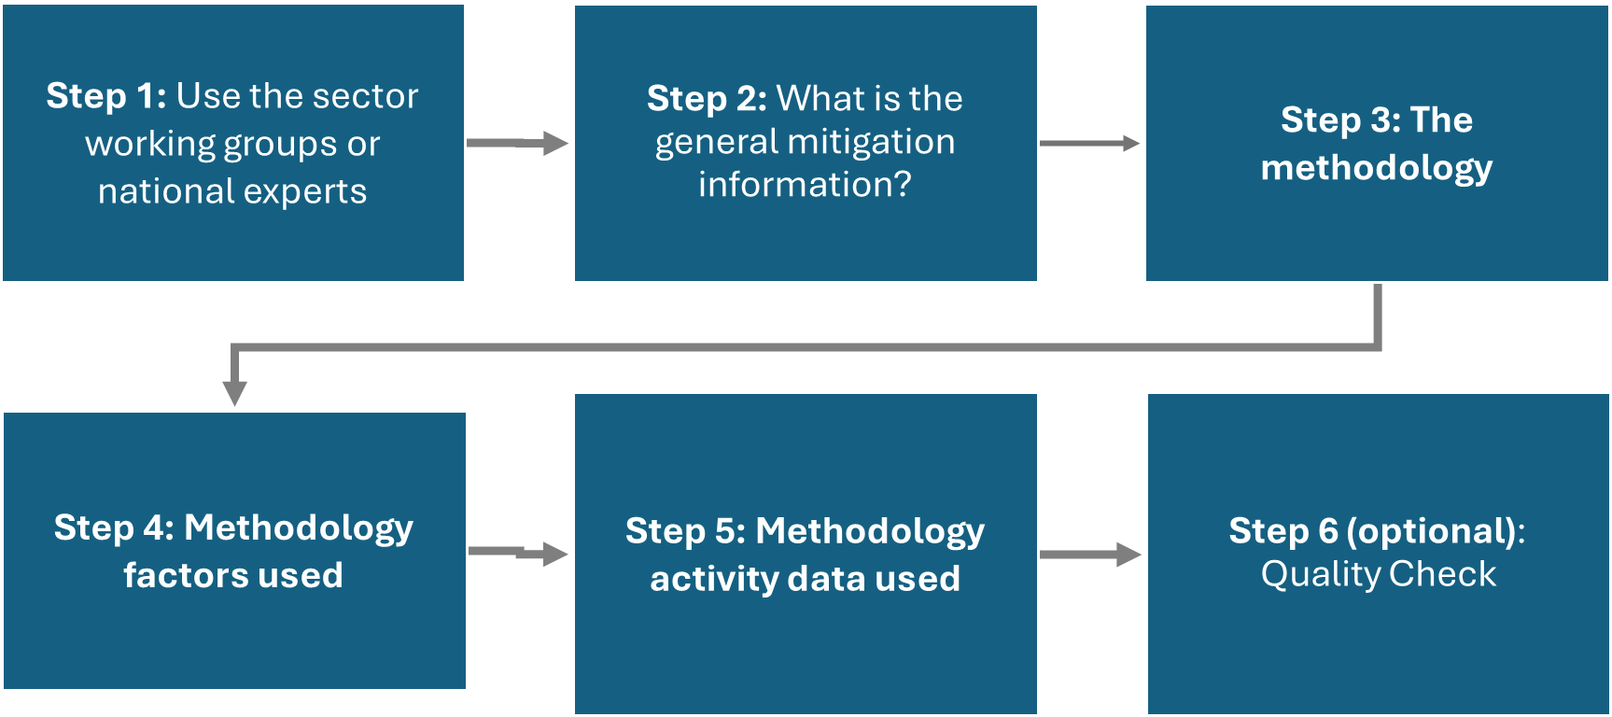
Advanced Impact Information Screening

Slide 29
Step 1: Use the sector working groups or experts
Sector Groups: Identify the working groups or national experts that will be able to map the programmatic information for each sector.

Slide 30
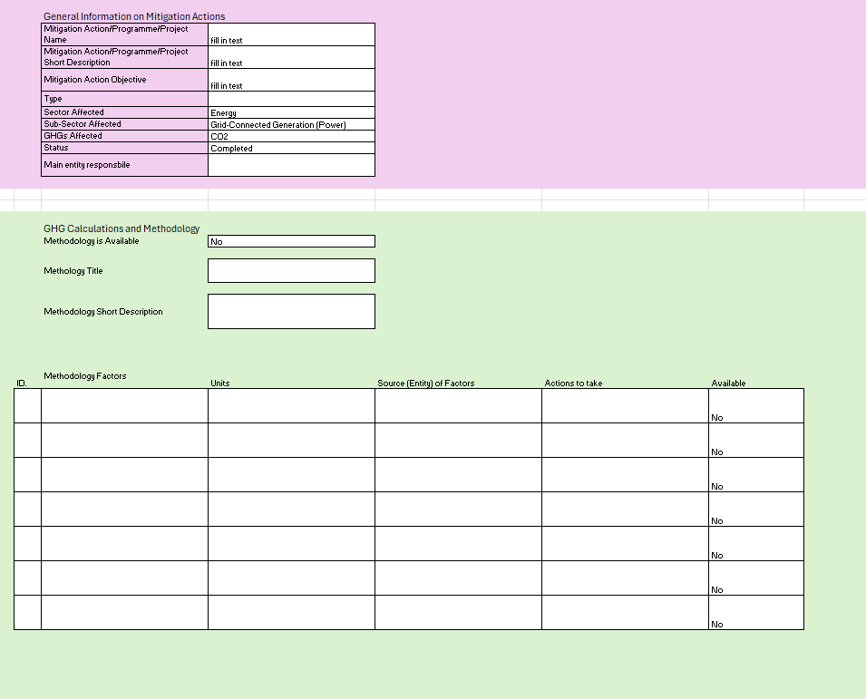
Step 2: What is the general mitigation information?
Step 3: The methodology?
Information: The impact methodology may already be determined in the previous processes. If it is or is not determined, then the general information for the methodology can be included in the Advanced Impact Sheet tool. The related action, programme, or project information should be included.
The Methodology: Sectoral experts should help determine the exact methodology, which may already be done in the previous process, for the impact methodology. The methodology should have a well-documented approach, mathematics, and indicated data needs.

Slide 31
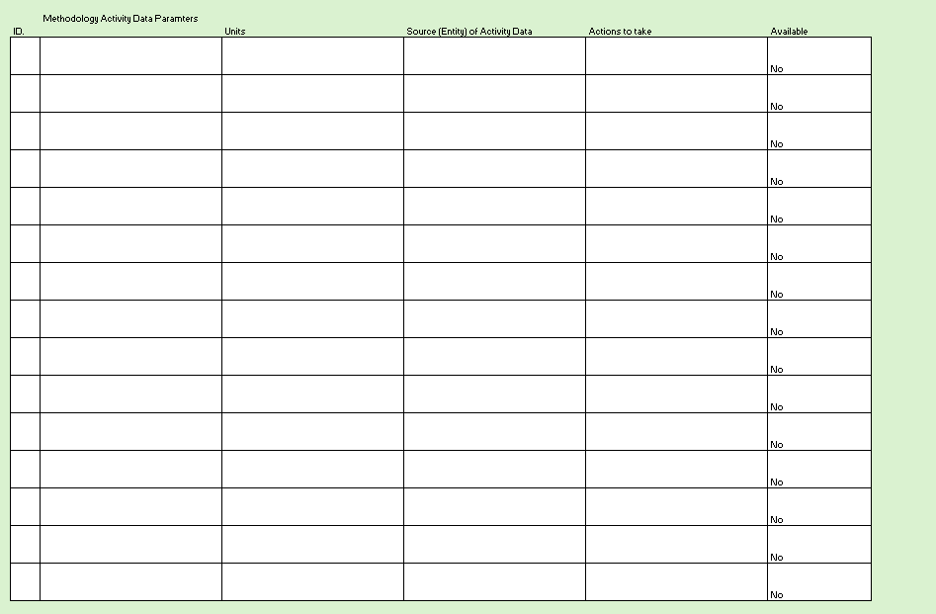
Step 4: Methodology factors used
Step 5: Methodology activity data used
Factors: Standard or country-specific methodology factors will be used if the methodology measures quantitative impact. These are typically emissions factors and/or activity factors that are fixed within the methodology. The names of the factors, units, and sources of factors should be recorded.
Activity data: If the methodology measures quantitative impact, country-specific activity data will be collected. This relates directly to the action, programme, or project and are the scalable parameters used to measure progress. The name of the activity data parameter, units, and source of factors should be recorded.

Slide 32
(optional)
Step 6: Quality Check
Quality Check (validation):
It is proposed that one person from the working group (or two) be nominated to perform a quality check of the information inputted into the provided Advanced Impact Information tool. This person(s) will hold the combined draft and final mapping versions.

Slide 33

5. Insights for Some Sectors
Renewable Energy
Transport
Solid Waste
Agriculture
Forestry
UNITED NATIONS DEVELOPMENT PROGRAMME

Slide 34
Insights for Renewable Energy
Where to look for information
The most common sources of information for renewable energy impact are the ministries responsible for energy, customs, economy, rural communities, and statistics. Also information can be found at the national electricity authority and companies to generate/supply electricity.
Common basic information needs
Fuel types and fuel consumption data (national, companies, installations)
Fuel emissions factors and other conversion factors (for energy, mass and volumes)
Electricity generation amounts (national, companies, installations)
Generation capacities (by type of renewable technology)
Plant load factors / energy potentials (by type of renewable technology and location)
Grid-emissions factors (national and regional)
Off-grid-emissions factors (situation specific)

Slide 35
Insights for Transport
Where to look for information
The most common sources of information for transport impact are the ministries responsible for energy, transport, maritime & aviation authorise, customs, traffic & registrations, economy, and statistics.
Common basic information needs
Fuel types and fuel consumption data (national, suppliers and companies)
Electricity consumption (national, suppliers and companies)
Fuel emissions factors and other conversion factors (for energy, mass and volumes)
Registered numbers of vehicles, vessels, or aircraft by type & model
Imported numbers of vehicles, vessels, or aircraft by type & model
Standard emissions factors of vehicles, vessels, or aircraft by type & model
Age of vehicles, vessels, or aircraft
Vehicle emissions limits or labels by type & model
Average annual distances travelled by vehicles, vessels, or aircraft by type & route
Electricy methodologies may be needed

Slide 36
Insights for Solid Waste
Where to look for information
The most common sources of information for solid waste impact are the ministries responsible for environment and statistics. As well as authorities and companies operating waste management.
Common basic information needs
Waste generation by person (urban or rural) and/or measured at management facilities
Waste disposal by type (composting, landfilling, burning/incineration…)
Landfill conditions
Waste composition (especially organics)
Waste water content
Waste energy content
Waste carbon content
Landfill gas amounts recovered, flares or utilised for energy

Slide 37
Insights for Agriculture
Where to look for information
The most common sources of information on agriculture's impacts are the ministries responsible for agriculture, statistics, customs, industry, and rural communities. As well as companies operating in the agriculture space (especially SOEs).
Common basic information needs
Numbers of livestock by type
Days livestock is alive
Various CH₄ emissions factors by livestock type – Tier 1
Type of manure management
Energy intake of livestock by type (specific equations)
Volatile solids of livestock by type (specific equations)
Average animal mass
Measured biogas generation and/or combustion
Emissions factors for N₂O from manage soils
Amounts of fertilisers applied by type (organic and inorganic/synthetic)
Crop yields by type
Various CH₄ emissions factors by per type of crop (rice)
Land under cultivation by type of drop

Slide 38
Insights for Forestry
Where to look for information
The most common sources of information on agriculture's impacts are the ministries responsible for forestry, agriculture, statistics, customs, industry, and rural communities. As well as companies operating in the agriculture and forestry space (especially SOEs).
Common basic information needs
Area with forests/trees
Growing stock volumes per ha by species of trees and climatic zones
Carbon fraction of above ground mass of biomass by species of trees and climatic zones
Ratio of below ground mass of biomass by species of trees and climatic zones
Removal, harvested, and insect disturbance of stock volumes by species of trees and climatic zones
Above-ground biomass factors by region and ecological zone in forests and plantations
Above-ground biomass growth by region and ecological zone in forests and plantations
Wodd density by species

Slide 39
6. Other Useful Resources
National Climate Transparency Platform (NCTP):
GitHub resources (software)
Software demo website
Enhanced Transparency Framework:
UNFCCC Transparency Website
UNFCCC ETF Reporting Tools
ETF Modalities Procedures and Guidelines 18/CMA1
ETF Reporting Tables 5/CMA3
UNITED NATIONS DEVELOPMENT PROGRAMME

Slide 40

Other Useful Resources (cont.)
Methodologies sources:
2006 IPCC Guidelines for National Greenhouse Gas Inventories
CDM Methodology Booklet (simple catalogue of methodologies)
CDM Methodologies Website
CDM Sustainable Development Tool v1.1
VCS Program Methodologies
Sustainable Development Verified Impact Standard
Forestry
UNFCCC REDD+ platform

Slide 41

Other Useful Resources (cont.)
Paris Agreement Crediting Mechanism
Information on the Paris Agreement Crediting Mechanism Article 6.4
Paris Agreement Cooperative Approaches
Information on the Paris Agreement Cooperative Approaches Article 6.2
Paris Agreement Non-market Approaches
Paris Agreement Non-market Approaches Article 6.8

Slide 42

Feel free to contact the UNDP Digital For Planet team for more information
DIGITAL 4 PLANET
Contact UNDP Digital For Planet at:
digital4planet@undp.org
42
UNITED NATIONS DEVELOPMENT PROGRAMME

